Slide 1
Bankruptcy
Prediction
Project Presentation by Group 3

Slide 2
Introduction
Milestones
EDA
Agenda
Statistical Analysis
Evaluation Metrics
Modeling
Evaluation Result
Deployment

Slide 3

Introduction
Analyse the Dataset and Draw inference from it.
Train & Evaluate ML Models to Perform Predictions.
Back to Agenda Page

Slide 4
Milestones
Statistical Analysis
Modeling & Evaluation
EDA
Draw statistical inference from the dataset, also perform required statistical tests.
Deployment
Train & Evaluate the models also select the best model for deployment.
Analyse the dataset for inference.
Deploy the model on the internet.
Back to Introduction Page

Slide 5
EDA
Check For Null Values
Machine Learning Models can't handle null values.
We didn't find any null values in our dataset.
Analyse Target Column
Our Target Column has 2 possible values bankruptcy or non-bankruptcy.
Our Dataset has 57.2% non-bankruptcy instances and 48.2% bankruptcy instances.
Analyse Feature Column
Each of our feature column exhibit categorical nature.
Possible values are 0 , 0.5 , 1 which represent low, medium and high respectively.
Back to Milestones Page

Slide 6
EDA
Blue represent Non-Bankruptcy , Green represents Bankruptcy.
57.2% Non-Bankruptcy rows of data.
42.8% Bankruptcy rows of data
Bankruptcy
42.8%
Non-Bankruptcy
57.2%
Back to EDA Page

Slide 7
Statistical Analysis
Feature Column | Significance
Industrial Risk | True
Management Risk | True
Financial Flexibility | True
Credibility | True
Competitiveness | True
Operating Risk | True
We Used Chi-Square Statistical Test to Check if our feature colums are significantly related to our target column.
We Used Chi-Square test because both out target column and feature columns are categorical.
Back to EDA Page

Slide 8
Evaluation Metrics
The Evaluation Metrics we want to focus on is precision. Since in our dataset after target encoding, label 1 states that company will not go bankrupt but false-predicting any company that could get banckrupt is more impactful in our case.
Precision is the ratio of true positive predictions to the total number of positive predictions made by the model (true positives + false positives).
High precision means that the model makes fewer false positive errors.
We will also use classification record to measure recall and f1 score along with precision.
We will also use ROC-AUC Curve to visualize our model performance.
Back to Statistical Analysis Page

Slide 9
Modeling
We will use ML Packages like Scikit-learn, Catboost , Tensorflow to build Machine Learning Classification Models.
Models that we used are LogisticRegressor, LinearSVC, MultinomialNB, CategoricalNB, RandomForestClassifier, CatBoostClassifier, KNeighborsClassifier, DecisionTreeClassifier_gini, DecisionTreeClassifier_entropy.
We also used Dense Neural Network Model created using Tensorflow.
Back to Evaluation Metrics Page

Slide 10
Eval Result
*Top 4 Best Performing models
Model | Accuracy | Precision
LogisticRegressor | 1.0 | 1.0
RandomForestClassifier | 1.0 | 1.0
CatBoostClassifier | 1.0 | 1.0
Neural Network | 1.0 | 1.0

Slide 11
Deployment
For the Deployment we used Streamlit which provides us with simple easy to write script to create minimal web page.
We Also Provided two ways in which user can provide information to the model for prediction.
One Way is providing individual values for each feature columns.
Another way is by providing a dataset in csv format which has feature columns as columns.
Back to Eval Result Page

Slide 12
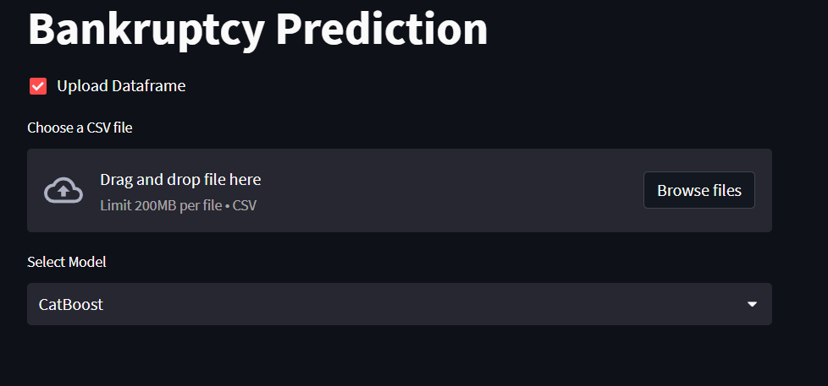
Deployment
Snapshots
*By Uploading the csv dataset

Slide 13
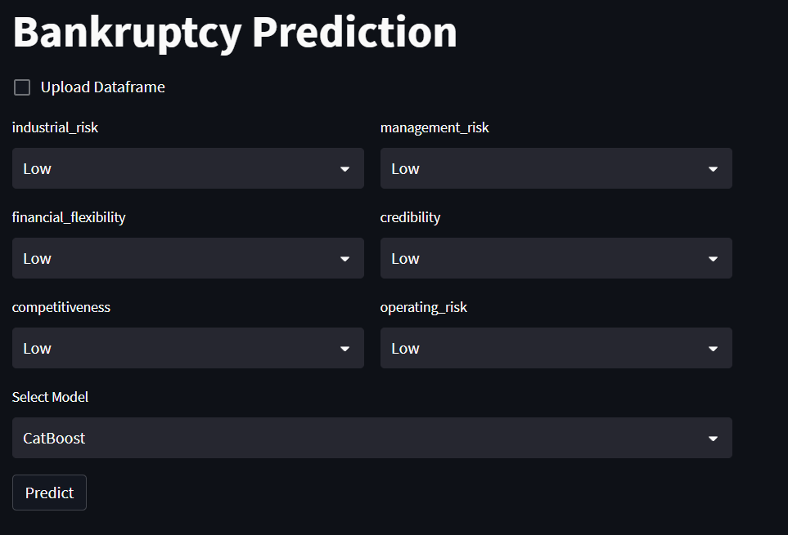
Deployment
Snapshots
*By providing individual values

Slide 14
Thank You

